Slide 1

Natural Language Processing
A Gentle Introduction

Slide 2

Why Natural Language Processing?
Computing devices have become a huge part of our lives
we generate tonnes and tonnes of data
we desire to know what the data is telling us
sometimes in real-time

Slide 3
Why Natural Language Processing?
We need our devices to “speak” to us
We desire systems that can listen to us
Understand what we say in human language
Act on our instructions and …
Communicate to us in human language

Slide 4
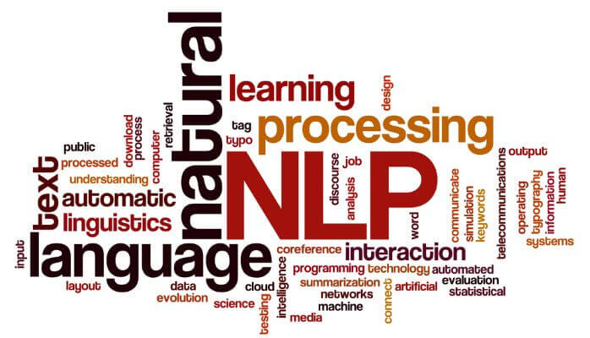
So what is Natural Language Processing?
a set of tools and techniques for processing human languages
enables effective human-machine interaction
extracts information from some generated data (often unstructured)

Slide 5

So what is Natural Language Processing?
defines how information is represented
parsing that information from the data generating process
construct and use efficient data structures that stores the model

Slide 6
Definition of Natural Language Processing?
In summary NLP is often defined as:
the study of the computational treatment of natural (human) language
It aims to:
create systems that understand and generate (produce) human language

Slide 7
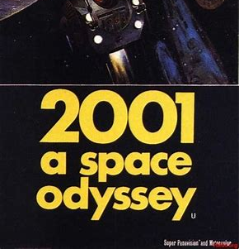
A Classic NLP Example?
Quote from the 1968 SciFi movie "2001: A Space Odyssey" by Stanley Kubrick
Dave Bowman: Open the pod bay doors, HAL.
HAL: I'm sorry Dave. I'm afraid I can't do that

Slide 8
Basic NLP Acronyms
NLP (Natural Language Processing)
CL (Computational Linguistics)
IR (Information Retrieval)
IE (Information Extraction)
HLT (Human Language Technology)
NLE (Natural Language Engineering)
ML (Machine Learning)

Slide 9
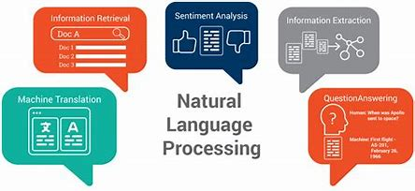
Common Applications of NLP

Slide 10

Machine Translation
MT deals with the study of the use of computer systems to translate text or speech from one language to another

Slide 11

Information Retrieval
obtaining relevant materials based on a query from a collection of information system resources

Slide 12
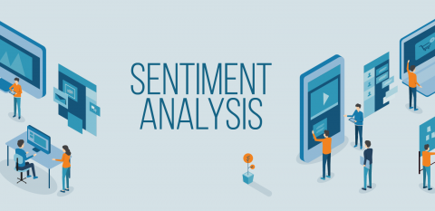
Sentiment Analysis aka opinion mining
refers to the use of natural language processing techniques and tools to identify, extract, quantify, and study affective states and subjective information.

Slide 13
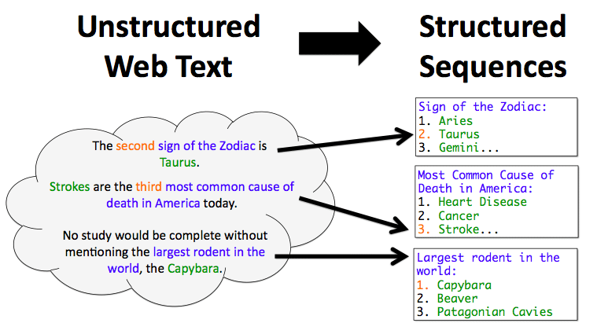
Information Extraction
automatically extraction of structured information from unstructured and/or semi-structured machine-readable documents.

Slide 14
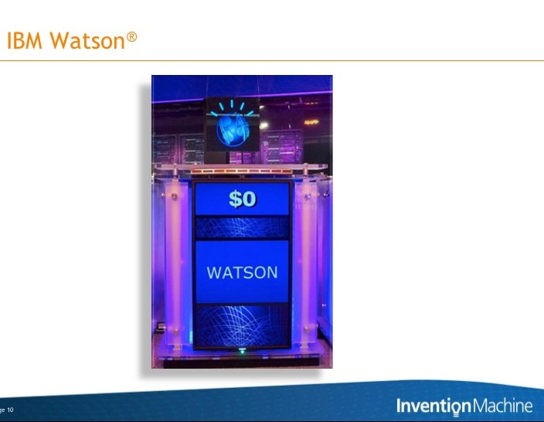
Question Answering
QA systems that answer questions posed by humans with natural language

Slide 15
Other Related NLP Applications
Text Categorization
Classify documents by topics, language, author, spam filtering, information retrieval (relevant, not relevant), sentiment classification (positive, negative)
Spelling & Grammar Corrections
Speech Recognition
Summarization
Dialog Systems
Language generation
Fact-checking
anti-fake news!

Slide 16
Why is NLP hard?

Slide 17
Humans Language Ambiguity lexical, phrase, semantic ambiguities
Iraqi Head Seeks Arms
Word sense is ambiguous (head, arms)
Stolen Painting Found by Tree
Thematic role is ambiguous: tree is agent or location?
Ban on Nude Dancing on Governor’s Desk
Syntactic structure (attachment) is ambiguous: is the ban or the dancing on the desk?
Hospitals Are Sued by 7 Foot Doctors
Semantics is ambiguous : what is 7 foot?

Slide 18
Language evolves
new words are constantly introduced
the parsing rules are flexible
ambiguity is inherent
meanings are context dependent

Slide 19
Language is subtle
He arrived at the lecture
He chuckled at the lecture
He chuckled his way through the lecture
**He arrived his way through the lecture
Language is complicated!

Slide 20
Language representation is unique
no know universal representation
often application-specific
world knowledge required for interpretation
many languages, dialects, styles etc.

Slide 21
Some key NLP tasks?

Slide 22
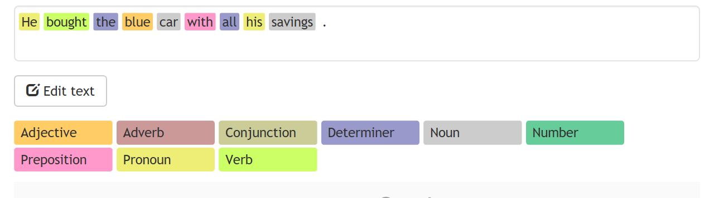
Part of Speech Tagging
Parts of speech tagging is one of the most fundamental tasks in NLP.
It involves using some techniques and statistics to understand the part of speech of a word.

Slide 23
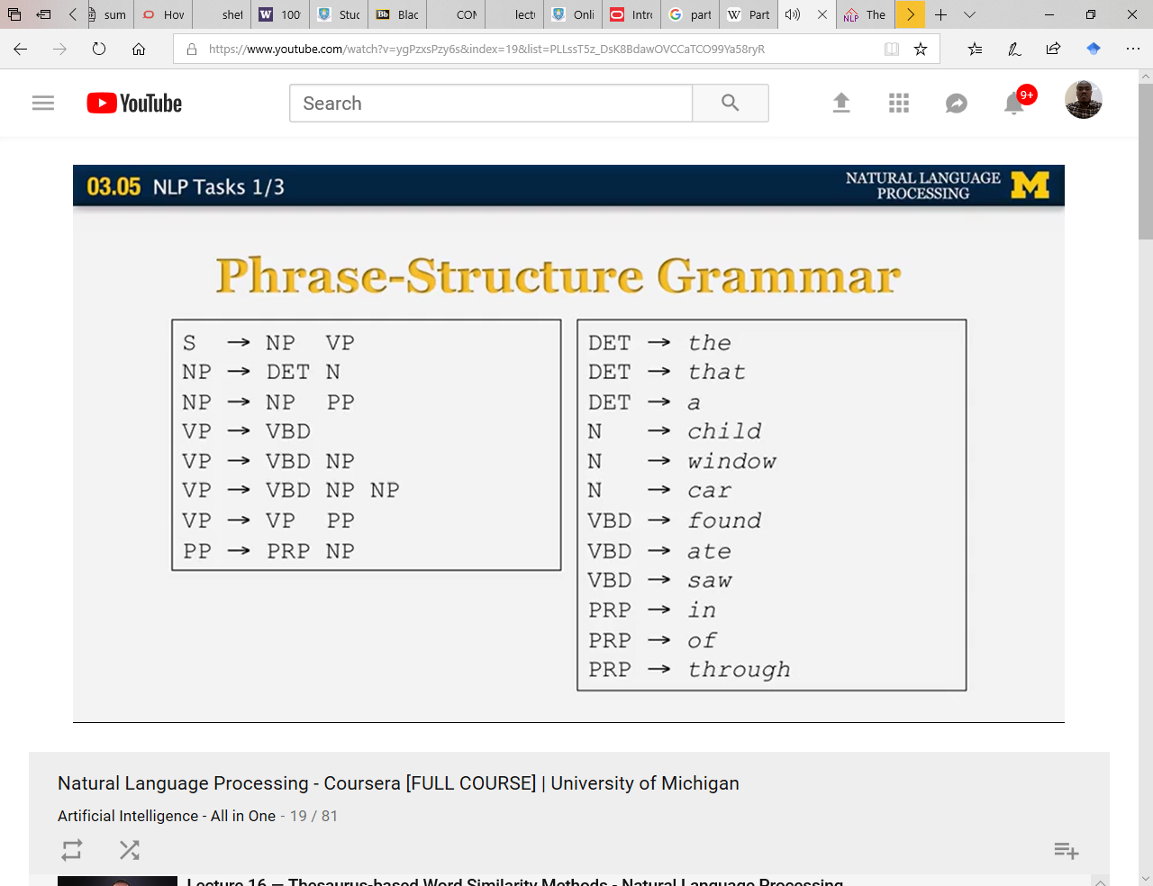
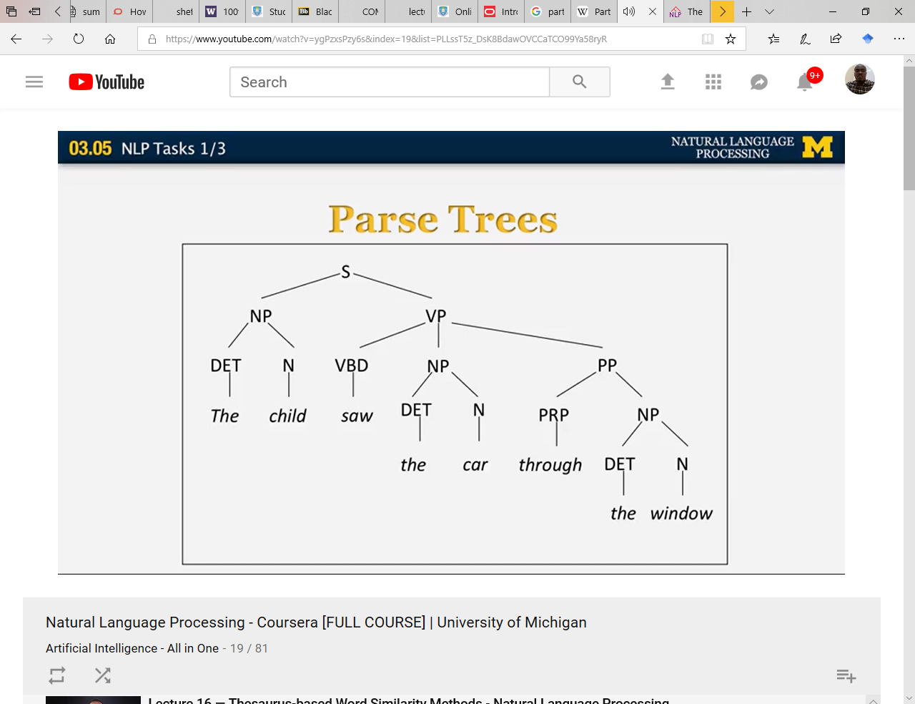
Parsing
Phrase-Structure Grammar
Parsing attempts to the build the parse tree of a sentence based on its grammar
A grammar could be phrase-structured or dependency grammar
Parse Tree

Slide 24
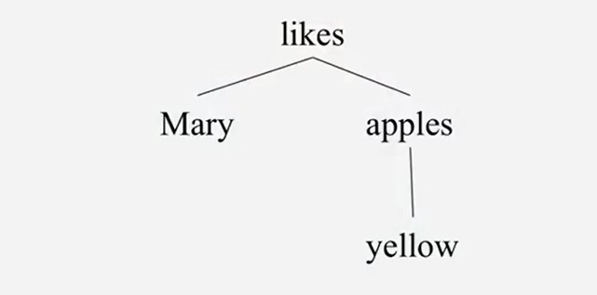
Parsing
Dependency Parse Tree for
Mary likes yellow apple
Parsing attempts to the build the parse tree of a sentence based on its grammar
A grammar could be phrase-structured or dependency grammar

Slide 25
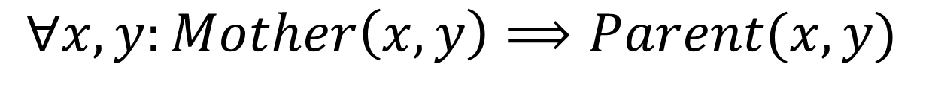
Semantic Analysis
Semantics analysis is a very essential task in NLP.
It deals with the logical representation of sentences in forms like first other logic
Inferences could easily be drawn from sum representations
$$∀x,y:Mother\left(x,y\right)⟹Parent(x,y)$$

Slide 26
Semantic Role Labelling
He wouldn’t accept anything of value from those he was writing about.
Semantic role labelling assigns multiple arguments to verbs which may or may not be required
From the example, the main verb, “accept-V” has other arguments as labelled
“A3: attribute” was not required in this case

Slide 27
Semantic Role Labelling
He wouldn’t accept anything of value from those he was writing about.
[_{A0} He] [_{AM-MOD} would] [_{AM-NEG} n’t] [_{V} accept]
[_{A1} anything of value] from [_{A2} those he was writing about]
Semantic role labelling assigns multiple arguments to verbs which may or may not be required
From the example, the main verb, “accept-V” has other arguments as labelled
“A3: attribute” was not required in this case

Slide 28
Semantic Role Labelling
He wouldn’t accept anything of value from those he was writing about.
[_{A0} He] [_{AM-MOD} would] [_{AM-NEG} n’t] [_{V} accept]
[_{A1} anything of value] from [_{A2} those he was writing about]
V: verb
A0: acceptor
A1: thing accepted
A2: accepted-from
A3: attribute
AM-MOD: modal
AM-NEG: negation
Semantic role labelling assigns multiple arguments to verbs which may or may not be required
From the example, the main verb, “accept-V” has other arguments as labelled
“A3: attribute” was not required in this case

Slide 29
Word Sense Disambiguation
Typically aims at resolving sense ambiguities e.g. bank
The fisherman jumped off the bank into the water.
The bank down the street was robbed!
We bank on his ability to deliver on the task.
The bank in that road is too steep and dangerous
Word sense disambiguation resolves sense ambiguities
It uses the context in which the word appears in to determine which sense is more appropriate
Sense inventories such as WordNet or electronic dictionaries are often used
Useful in Machine Translation

Slide 30
Word Sense Disambiguation
Typically aims at resolving sense ambiguities e.g. bank
The fisherman jumped off the bank₁ into the water.
The bank₂ down the street was robbed!
We bank₃ on his ability to deliver on the task.
The bank₄ in that road is too steep and dangerous
Word sense disambiguation resolves sense ambiguities
It uses the context in which the word appears in to determine which sense is more appropriate
Sense inventories such as WordNet or electronic dictionaries are often used
Useful in Machine Translation

Slide 31
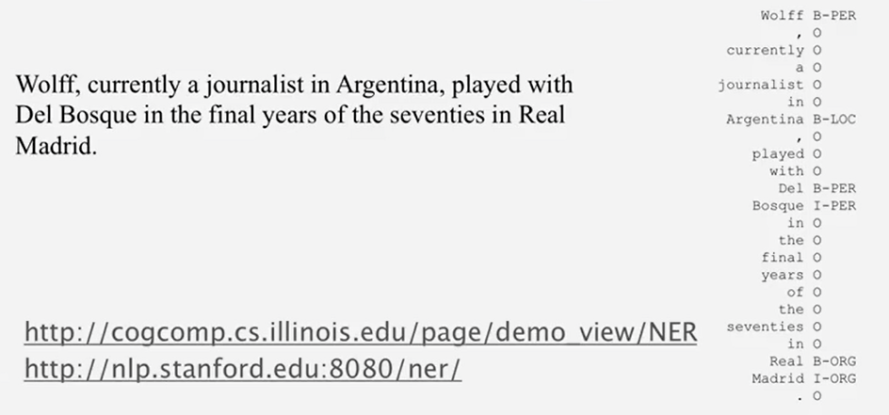
Named Entity Recognition
NER identifies the named entities in a sentence such as persons, locations and organisation
Where there is a combinations of words forming a named entity:
the first label starts with “B”: e.g. B-PERS
The inside labels starts with “I” i.e. I-LOC
Often used in information extraction

Slide 32
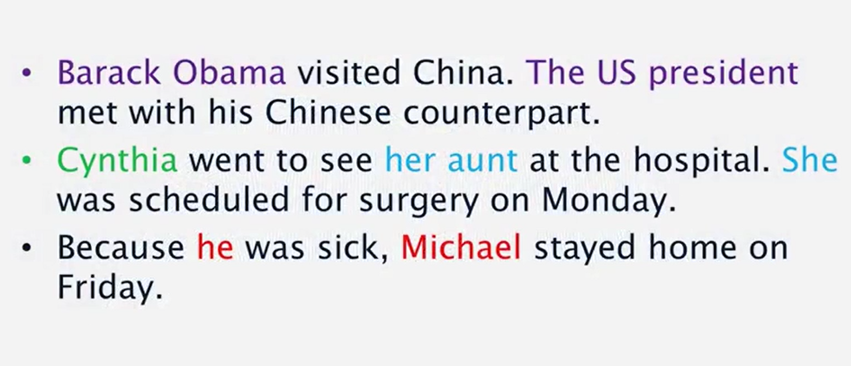
Coreference Resolution
Tries to understand when two phrases are referring to one person.
This is often used in discuss to avoid repetition
Anaphoric: entity mentioned first and then referred to later
Cataphoric: entity referred to before being mentioned

Slide 33
Basic Language Models

Slide 34
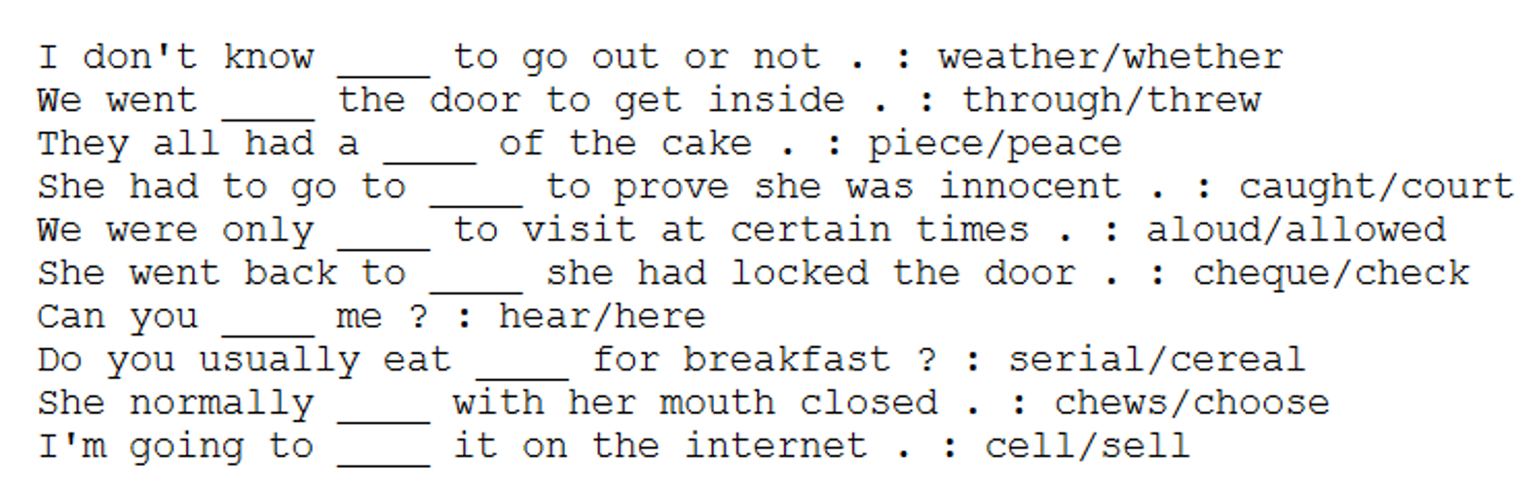
Consider this simple problem
Any idea how to get the computer to choose the right word to fill the blank?

Slide 35
Probabilistic Language Models
Which of the following is more probable?
Time flies like an arrow.
Fruit flies like a banana.

Slide 36
Probabilistic Language Models
Language models define the probability distribution over sequence of words (or sentences)
That is:
How likely is a given sentence to appear in the language?

Slide 37
Probabilistic Language Models
Common applications:
Speech recognition
P(“recognize speech”) > P(“recognize speech”)
Text Generation
P(“three houses”) > P(“three house”)
Spelling correction
P(“my cat eats fish”) > P(“my xat eats fish”)
Auto Completion
P(“give ___”[me]) > P(“give ___”[i])
Machine Translation
P(“the blue house”) > P(“the house blue”)
Other uses:
OCR
Summarization
Document classification

Slide 38

Probabilistic Language Models
Given a sentence with $n,$ words: $S=[w_{1},w_{2},w_{3},…,w_{n}]$ the language model computes the probability:
$P(S_{n})=P(w_{1},w_{2},w_{3},…,w_{n})$
Predicting the next word $w_{n+1}$:
The probability of $S_{n+1},$ $P(S_{n+1})$
$P({w_{n+1}|w}_{1},w_{2},w_{3},…,w_{n})$
?

Slide 39

Probabilistic Language Models
Predicting the next word $w_{n+1}$:
The probability of $S_{n+1},$ $P(S_{n+1})$
$P({w_{n+1}|w}_{1},w_{2},w_{3},…,w_{n})$
Using the chain rule:
$P\left(w_{1}\right)P\left(w_{2} | w_{1}\right)…P(w_{n+1}|w_{1},w_{2}…w_{n})$
Example: $P(“I love Naija jollof rice”)$?

Slide 40

Probabilistic Language Models
Example:
$P(“I love Naija jollof rice”)$?
Solution:
$P\left(“I”\right)$*
$P\left(“love” | “I”\right)$*
$P\left(“Naija” | “I”,“love”\right)$*
$P\left(“jollof” | “I”,“love”,“Naija”\right)$*
$P\left(“rice” | “I”,“love”,“Naija”,“jollof”\right)$

Slide 41

Probabilistic Language Models
So predicting the next word in:
“I love Naija jollof _____” [yam/rice]
Compare:
$P\left(“yam” | “I”,“love”,“Naija”,“jollof”\right)$
and
$P\left(“rice” | “I”,“love”,“Naija”,“jollof”\right)$

Slide 42
N-Gram Models
Text = “I love Naija jollof rice”
1-gram aka unigram: “I”, “love”, “Naija”, “jollof”, “rice”
2-gram aka bigram: “I love”, “love Naija”, “Naija jollof”, “jollof rice”
3-gram aka trigram: “I love Naija”, “love Naija jollof”, “Naija jollof rice”

Slide 43
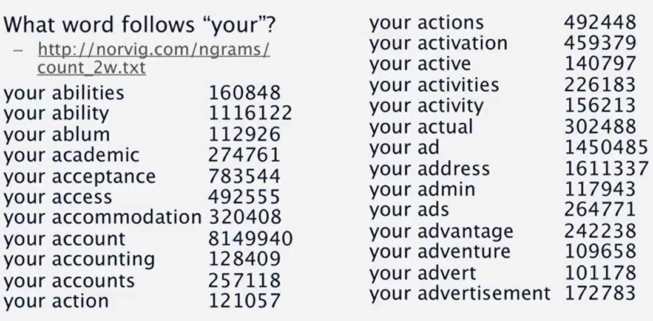
Bigram Counts
Words that follow “your”?
norvig.com/ngrams/count_2w.txt

Slide 44

N-Gram Models
Markov Assumption:
Only use a limited history..
So given: $S = “I love Naija jollof rice”, P(S)$ is
unigram: $P(“I")P(“love”)P(“Naija”)P(“jollof”)P(“rice”)$
bigram: $P\left(“I\text{)}\text{P}\text{(“}\text{love}\text{”|“}\text{I}\right)…P(“rice”|“jollof”)$
trigram:$P(“I")P(“love”|“I")P(“Naija”|“I", “love”))…$

Slide 45

Estimating N-Gram Probabilities
Maximum likelihood estimation:
$P(w_{1}|w_{2}) = \frac{count(w_{1},w_{2})}{count(w_{1})}$
Counts collected over a large (hundreds of billions) text corpus¹ over available on the web
¹Corpus (pl. corpora) is simply a collection of text

Slide 46
Looking at this again
Any idea how to get the computer to choose the right word to fill the blank?

Slide 47

N-Gram Models
“I don’t know _________ to go out or not”
options: “weather” vs “whether”
unigram: $P(“weather”)$vs $P(“whether”)$
bigram: $P(“weather”|"know")$vs $P(“whether”|"know")$
trigram:
$P(“weather”|"don′t know")$vs $P(“whether”|"don′t know")$

Slide 48

Data Sparsity and Smoothing
We may not see all the counts we need in our text corpus
What if a word (say “Naija”) is not in the text corpus
$$P\left(Naija\right|I love)=0$$
because:
$$count(Naija)=0$$
We use a technique called smoothing to avoid it

Slide 49

Laplace (Add-One) Smoothing
For all possible n-grams, add the count of one
$$p=\frac{c+1}{n+v}$$
where:
c = count of n-grams in corpus
n = count of history
v = vocabulary size
Add-$α$: a variant of this technique that adds $α$ to c.

Slide 50

Back-off
Back of is also a technique for dealing with unseen n-grams
With a trigram model, if $count(Naija) = 0$ then:
$P(yam|Naija jollof)$and
$P(rice|Naija jollof)$
But we still can compare by backing-off to bigram:
$P(yam|jollof)$ and
$P(rice|jollof)$

Slide 51
Common Smoothing Techniques
Additive smoothing
Good-Turing estimate
Jelinek-Mercer smoothing (interpolation)
Katz smoothing (backoﬀ)
Witten-Bell smoothing
Absolute discounting
Kneser-Ney smoothing
A good description of each could be found here:
https://nlp.stanford.edu/~wcmac/papers/20050421-smoothing-tutorial.pdf

Slide 52
Word Embedding Models

Slide 53
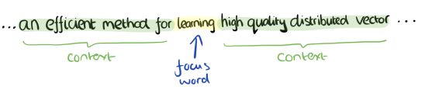
Word embedding models
Been around for a while but made popular by the Mikolov et al, 2013
Vector space models that captures relationships between words surprisingly well
Uses dense vector representation
Efficient unsupervised training on data
Examples:
word2vec
GLoVe

Slide 54

Word embedding models
Embeddings capture interesting relationship from data

Slide 55
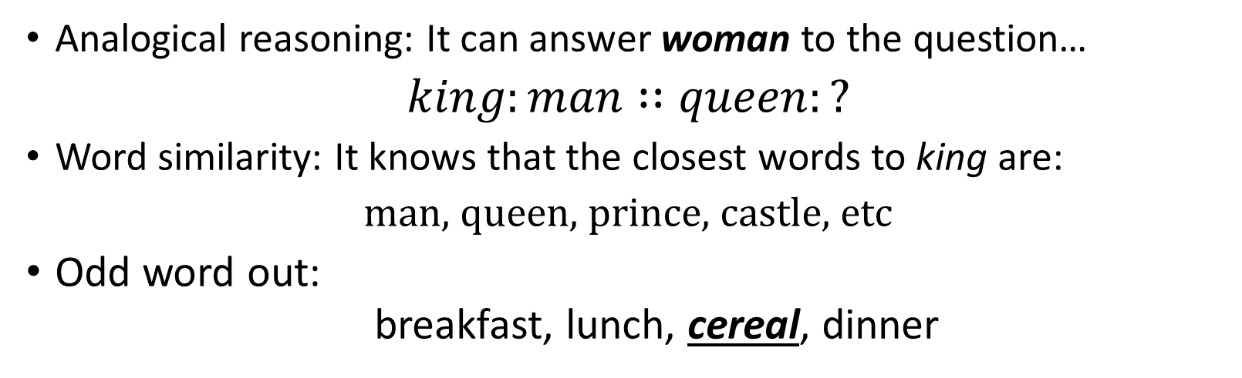
Evaluating embedding models
Analogical reasoning: It can answer woman to the question…
$king:man∷queen:?$
Word similarity: It knows that the closest words to king are:
man, queen, prince, castle, etc
Odd word out:
breakfast, lunch, cereal, dinner

Slide 56
Open Problems in NLP

Slide 57
References and Resources
Books
Speech and Language Processing
Dan Jurafsky and James Martin
http://www.cs.Colorado.edu/~martin/slp.html
Foundations of Statistical Natural Language Processing
Chris Manning and Hinrich Schutze
https://nlp.Stanford.edu/fsnlp
Natural Language Understanding
James Allen

Slide 58
References and Resources
University Online Courses:
Johns Hopkins University (Jason Eisner)
Cornell University (Lillian Lee)
Stanford University (Chris Manning)
U. Maryland (Hal Daume)
Berkeley (Dan Klein)
U. Texas (Ray Mooney)

Slide 59
References and Resources
Other Online Courses:
Coursera
Chris Manning & Dan Jurafsky (2012) Basic Intro
Michael Collins (2013, more advance)
Stanford CoreNLP
NLTK: Natural Language Toolkit
Chris Manning (Stanford University) https://youtu.be/OQQ-W_63UgQ
Dragomir Radev (University of Michigan) https://youtu.be/n25JjoixM3I

Slide 60
References and Resources
Lecture Materials
Andreas Vlachos: (Cambridge University)
http://andreasvlachos.github.io//teaching/
Mark Hepple: (University of Sheffield)
https://staffwww.dcs.shef.ac.uk/people/M.Hepple/campus_only/COM3110/

Slide 61
References and Resources
Major Conferences (and Journals):
ACL = Annual Meeting of the Association of Computational Linguistics
NAACL-HLT = Annual Conf North American Association of Computational Linguistics
EMNLP = Conference on Empirical Methods in Natural Language Processing
COLING = International Conference on Computational Linguistics
NIPS -
EACL = European Association of Computational Linguistics
LREC = Language Resources and Evaluation Conference
INTERSPEECH = Conference of the International Speech Communication Association

Slide 62
References and Resources
Books
Speech and Language Processing
Dan Jurafsky and James Martin
http://www.cs.Colorado.edu/~martin/slp.html
Foundations of Statistical Natural Language Processing
Chris Manning and Hinrich Schutze
https://nlp.Stanford.edu/fsnlp
Natural Language Understanding
James Allen

Slide 63


For listening…

